Slide 1
SINBAD: Set INspection Based Anomaly Detection
Niv Cohen, Issar Tzachor & Yedid Hoshen
The Hebrew University

Slide 2
Anomaly Detection
Objective: Discovering rare, interesting phenomena

Slide 3
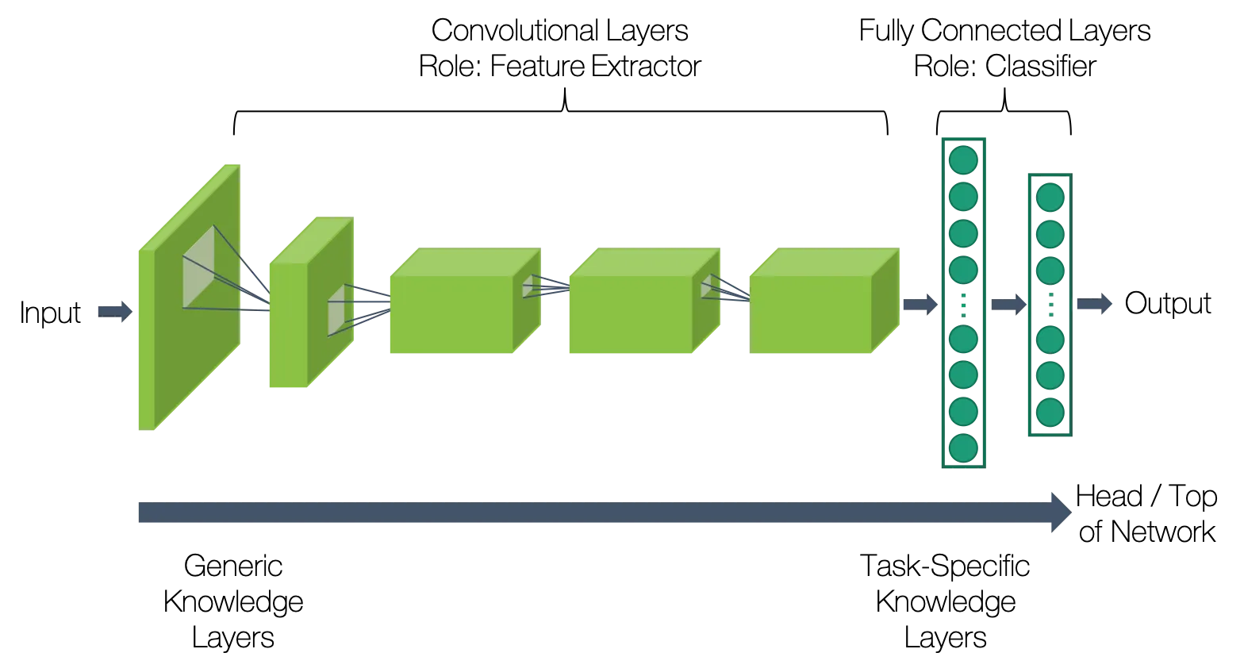
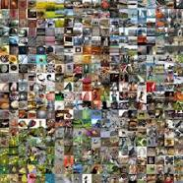
Simple but Powerful AD Paradigm
DN2 (Bergman, Cohen, Hoshen, 20’) proposed to detect anomalies by:
Each train image: extract deep representations using foundation model
Test image: compute kNN representation distance to training set
Large kNN distance - anomaly

Slide 4
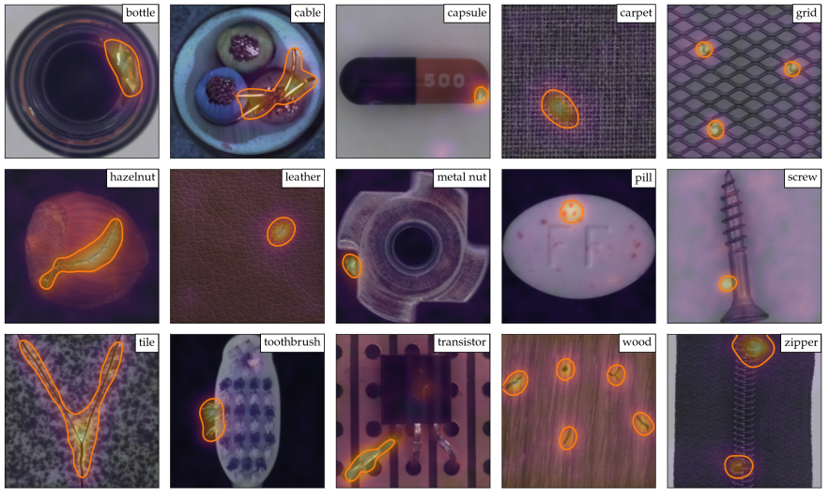
Segmentation-Based Anomaly Detection
Two-stage approach for cases where anomalies are localized:
For each patch – detect if normal or anomalous
If any patch is anomalous – image declared anomalous
Roth, Karsten, et al. "Towards total recall in industrial anomaly detection." Proceedings of the IEEE/CVF Conference on Computer Vision and Pattern Recognition. 2022.

Slide 5
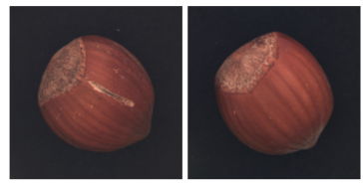
Logical Anomalies: Anomalous Combination of Normal Elements
Past: Anomalous Elements
Present: Anomalous Combination of Normal Elements
Bergmann, Paul, et al. "Beyond dents and scratches: Logical constraints in unsupervised anomaly detection and localization." International Journal of Computer Vision 130.4 (2022): 947-969.

Slide 6
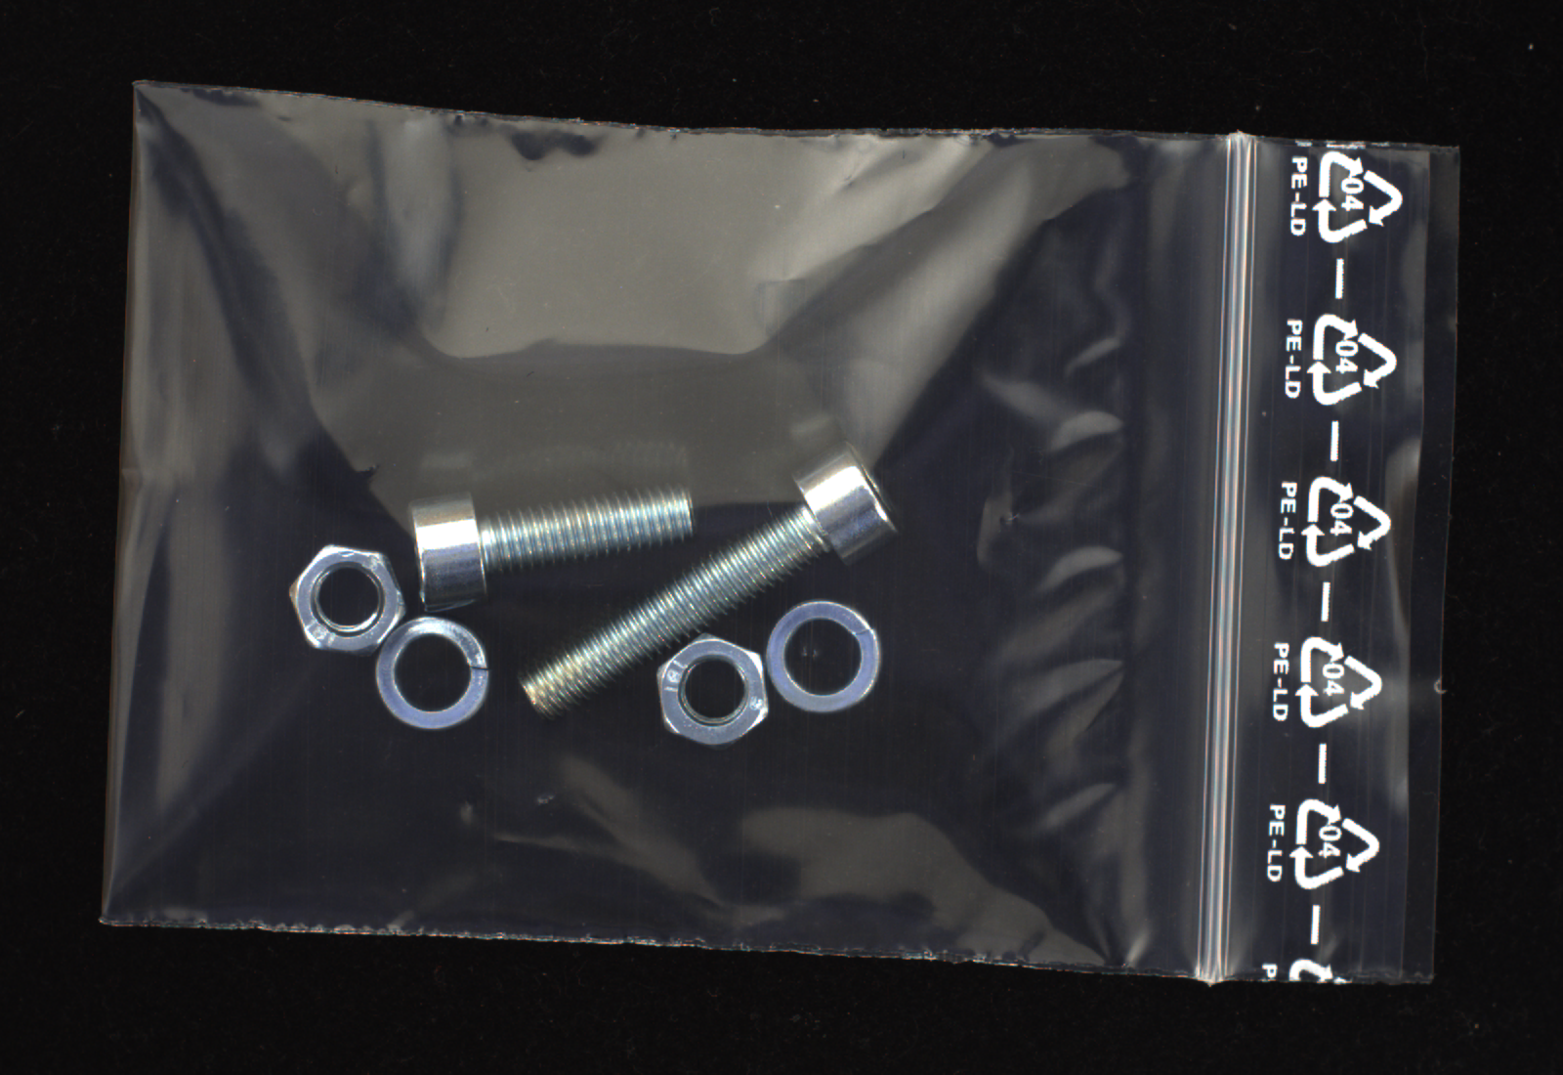
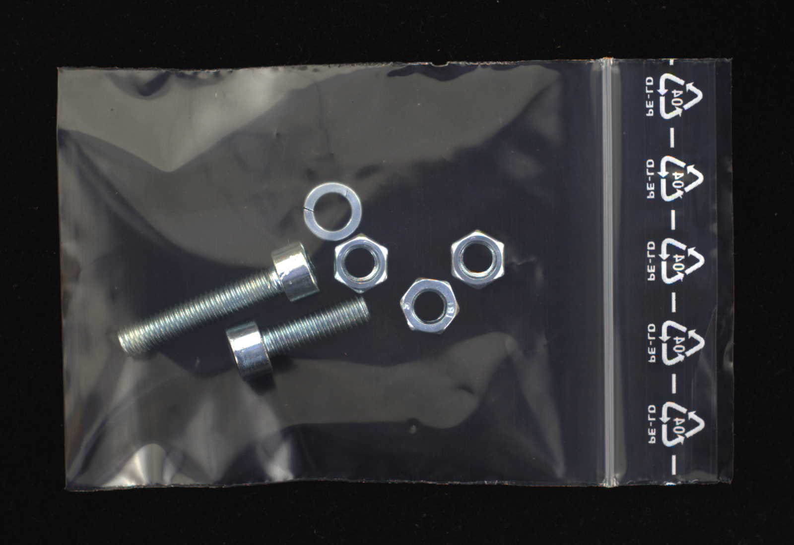
Logical Anomalies - Example
Normal sample Anomalous sample

Slide 7
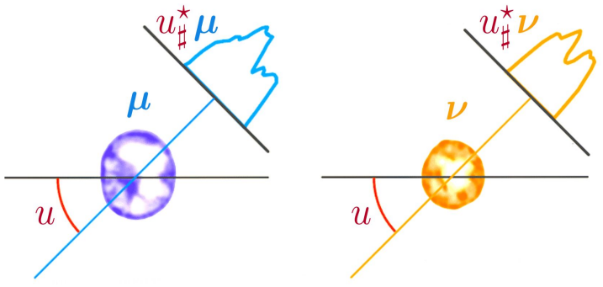
Anomaly Detection for Sets
Each sample represented as a set of local elements
Represent the distribution of elements, but not their order
Detect anomalies using density estimation of set descriptors
Nadjahi, Kimia. Sliced-Wasserstein distance for large-scale machine learning: theory, methodology and extensions. Diss. Institut polytechnique de Paris, 2021.

Slide 8
Naive Solution: Average Pooling
Preliminary idea for set feature: average of element features
Good: when average is enough to separate distributions
Bad: for more fine-grained differences
Need a more powerful two-sample metric!

Slide 9
Modeling Higher Moments: Projection Features
Set distance calculation:
Algorithm:
Generate a random vector P
Project features of all elements on P
For each image, compute histogram of projected values
Repeat the above for ~500 projections
For each image, concatenate all histograms
Anomaly scoring: kNN on histogram features
(Modified version of Sliced Wasserstein Distance)

Slide 10
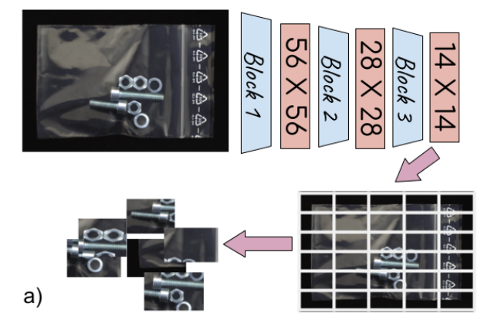
Element Descriptors: Images
Embed each patch using a pretrained ResNet (dense features, multiple blocks)
Image: set of patch embeddings

Slide 11
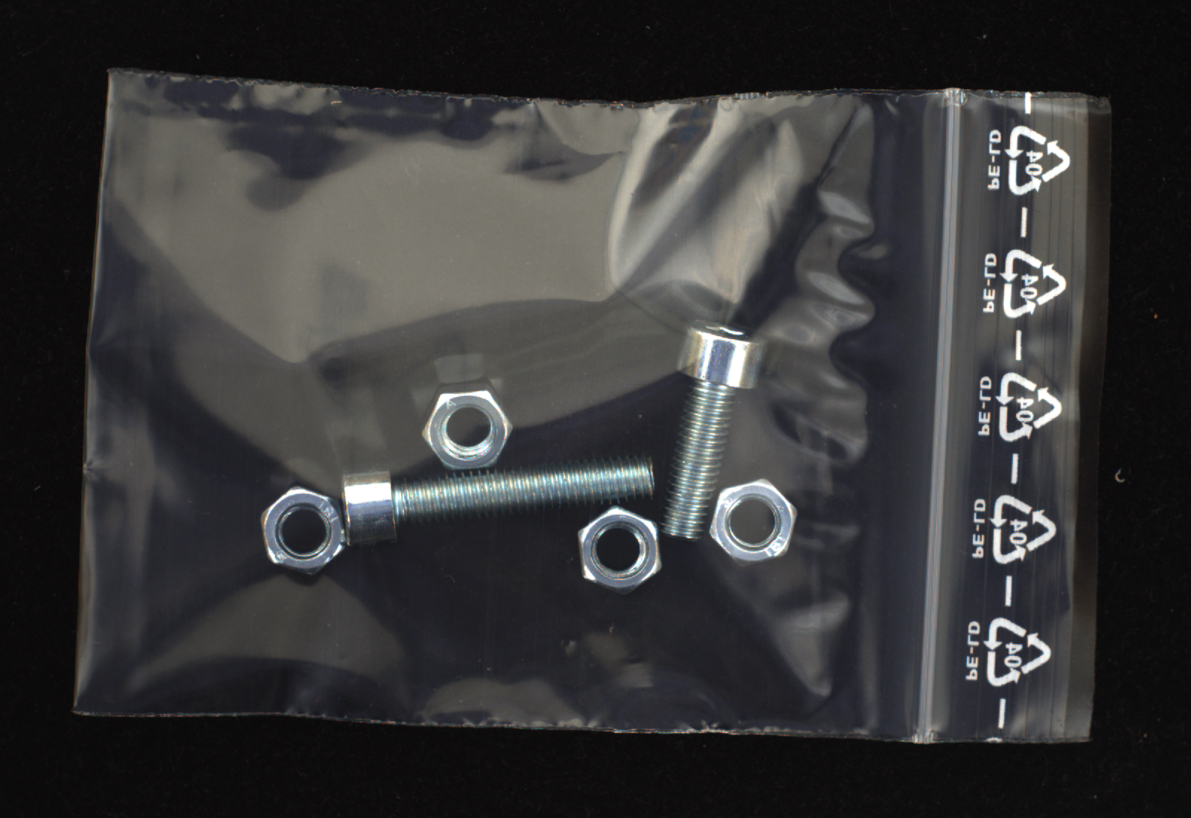
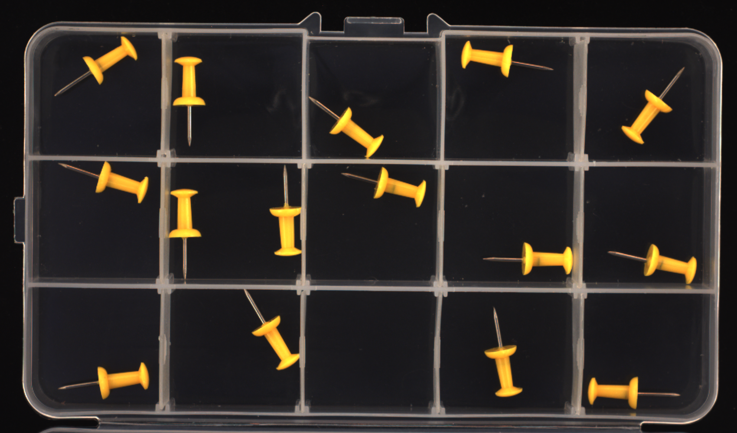
Evaluation on MVTec-LOCO
SoTA performance
Complementary strength with GCAD: Locality vs. Set
Bergmann, Paul, et al. "Beyond dents and scratches: Logical constraints in unsupervised anomaly detection and localization." International Journal of Computer Vision 130.4 (2022): 947-969.

Slide 12
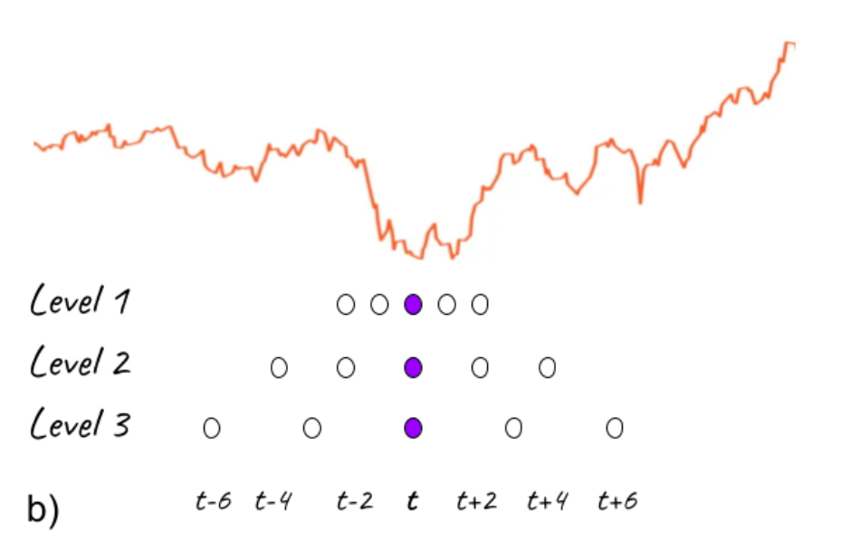
Element Descriptors: Series-level Time series AD
Detecting anomalous time-series - global rather than local anomalies
Each time-location is an element
Descriptors: pyramid of neighboring points
No deep learning

Slide 13
Series-level Time series AD: Results
SoTA results
Our shallow method outperforms DL methods

Slide 14
Summary
Set representation is key for logical anomaly detection
Complementary strengths with distillation based approaches
Works for both images and time-series

